Slide 1

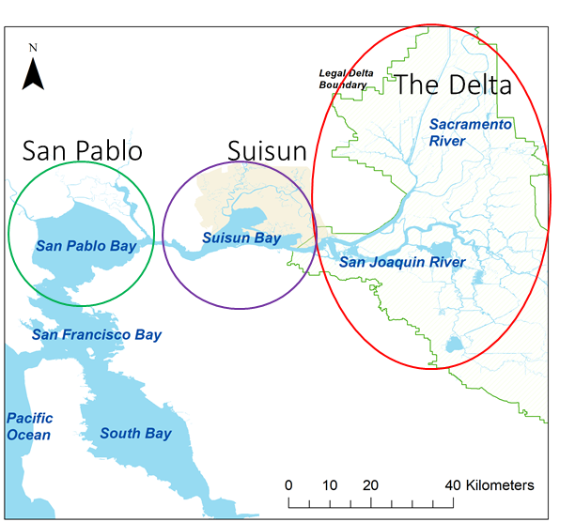
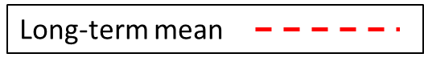
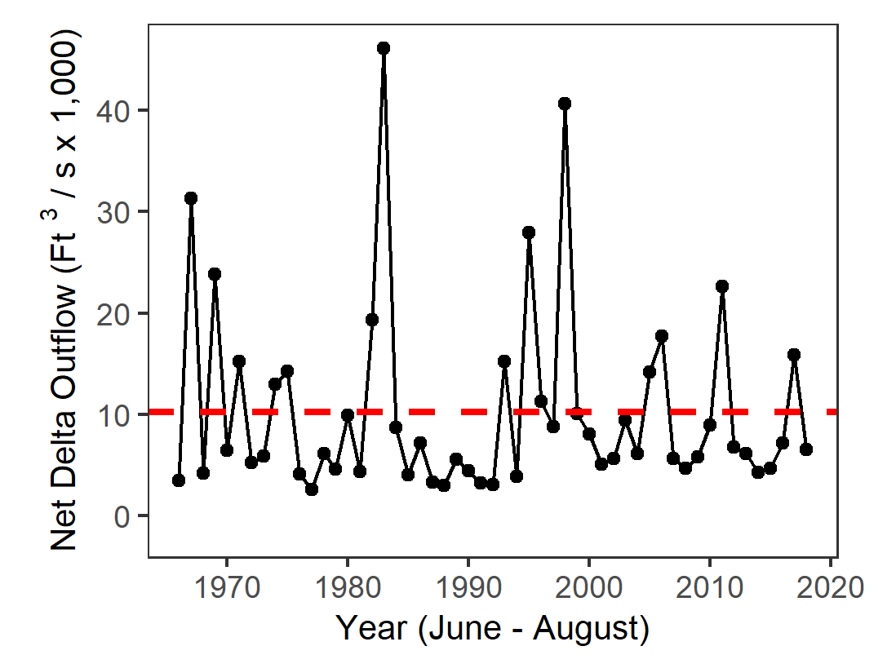
Summer 2018 IEP Seasonal Monitoring Report
Interagency Ecological Program for the San Francisco Estuary
This report shows trends in water quality, plankton, and fish across multiple IEP surveys for June, July, and August of 2018.
Regions of the Estuary
Delta Outflow
Contents
Secchi Depth……………..1
Temperature……………..2
Chlorophyll………………..3
Zooplankton………………4
Fish……………………………5
Fish (2004-2018)……….6
Metadata
Freshwater flow influences water quality, plankton, and fish populations.
Summer flow is driven primarily by rainfall, snowmelt, and upstream dam releases.
The Summer of 2018 had slightly lower outflow than normal.
Disclaimer: While substantial efforts are made to ensure the accuracy of these data, complete accuracy of data sets cannot be guaranteed. This report was developed by the IEP Synthesis Team.
For questions, comments, or corrections, contact Rosemary Hartman – Rosemary.Hartman@water.ca.gov

Slide 2
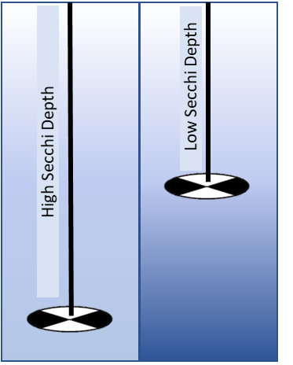
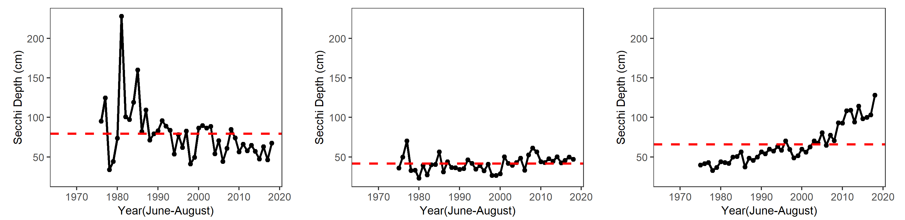
Secchi Depth
Interagency Ecological Program 2018 Summer Season Report
Secchi disk
Background
Organisms in this ecosystem are adapted to high turbidity conditions, and reductions in turbidity can have many negative ecological effects.
Higher values for Secchi depth indicate lower turbidity.
Secchi depth is measured monthly by DWR’s Environmental Monitoring Program by dropping a black-and-white disk in the water until it disappears.
For more information, see: Schoellhamer, D. H. 2011. Sudden clearing of estuarine waters upon crossing the threshold from transport to supply regulation of sediment transport as an erodible sediment pool is depleted: San Francisco Bay, 1999. Estuaries and Coasts 34(5):885-899.
San Pablo Bay
Suisun Bay
The Delta
In 2018, San Pablo bay was close to the long-term average.
In 2018, Suisun Bay was also close to the long-term average.
In 2018, the Delta was much clearer than average, the clearest Summer on record.

Slide 3

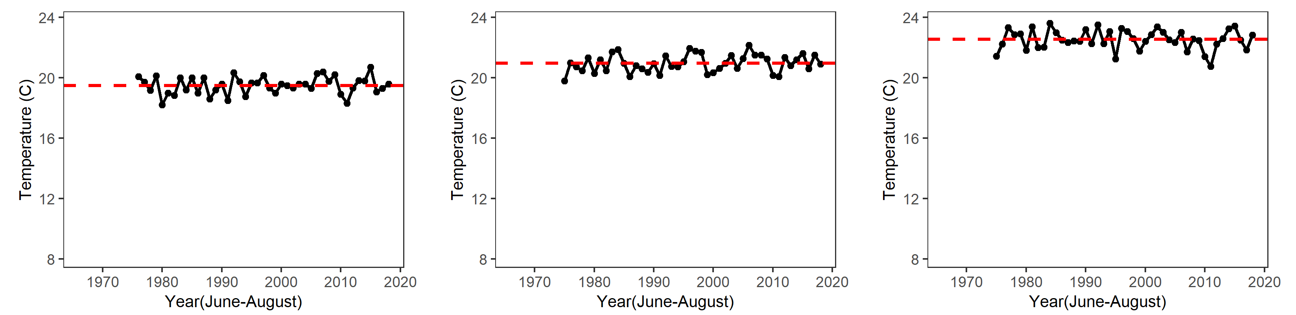
Water Temperature
Interagency Ecological Program 2018 Summer Season Report
Background
Water temperature is monitored monthly by DWR’s Environmental Monitoring Program.
High temperature can increase productivity and may trigger harmful algal blooms.
Increasing Summer temperatures may limit juvenile smelt survival.
Summer temperatures are lower closer to the ocean and slightly higher in the Delta.
For more information see: Lehman, P. W., T. Kurobe, S. Lesmeister, D. Baxa, A. Tung, and S. J. Teh. 2017. Impacts of the 2014 severe drought on the Microcystis bloom in San Francisco Estuary. Harmful Algae 63(Supplement C):94-108.
San Pablo Bay
Suisun Bay
The Delta
In 2018, San Pablo Bay temperatures were similar to the long-term average.
In 2018, Suisun Bay was similar to the long-term average.
In 2018, the Delta was similar to the long-term average.

Slide 4
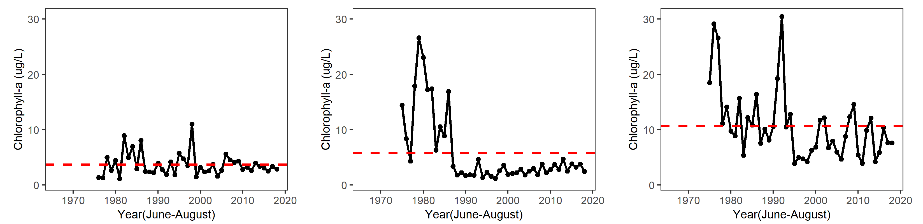
Chlorophyll
Interagency Ecological Program 2018 Summer Season Report
Background
Chlorophyll is an indicator of phytoplankton production, which is highest during the Summer.
Phytoplankton is the base of the pelagic food web. It is sampled monthly by DWR’s Environmental Monitoring Program.
The invasion of the clam Potamocorbula amurensis caused a decline in phytoplankton and zooplankton after 1986 – especially in Suisun Bay.
For more information see: Cahoon, T. and T. Brown 2018. Phytoplankton, Chlorophyll-a and Pheophytin-a Status and Trends 2017. IEP Newsletter 32(1):14-20.
Phytoplankton
San Pablo Bay
Suisun Bay
The Delta
In 2018, San Pablo Bay chlorophyll was about average.
In 2018, Suisun Bay chlorophyll was slightly below average.
In 2018, the Delta chlorophyll was also slightly below average.

Slide 5
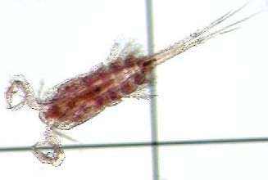
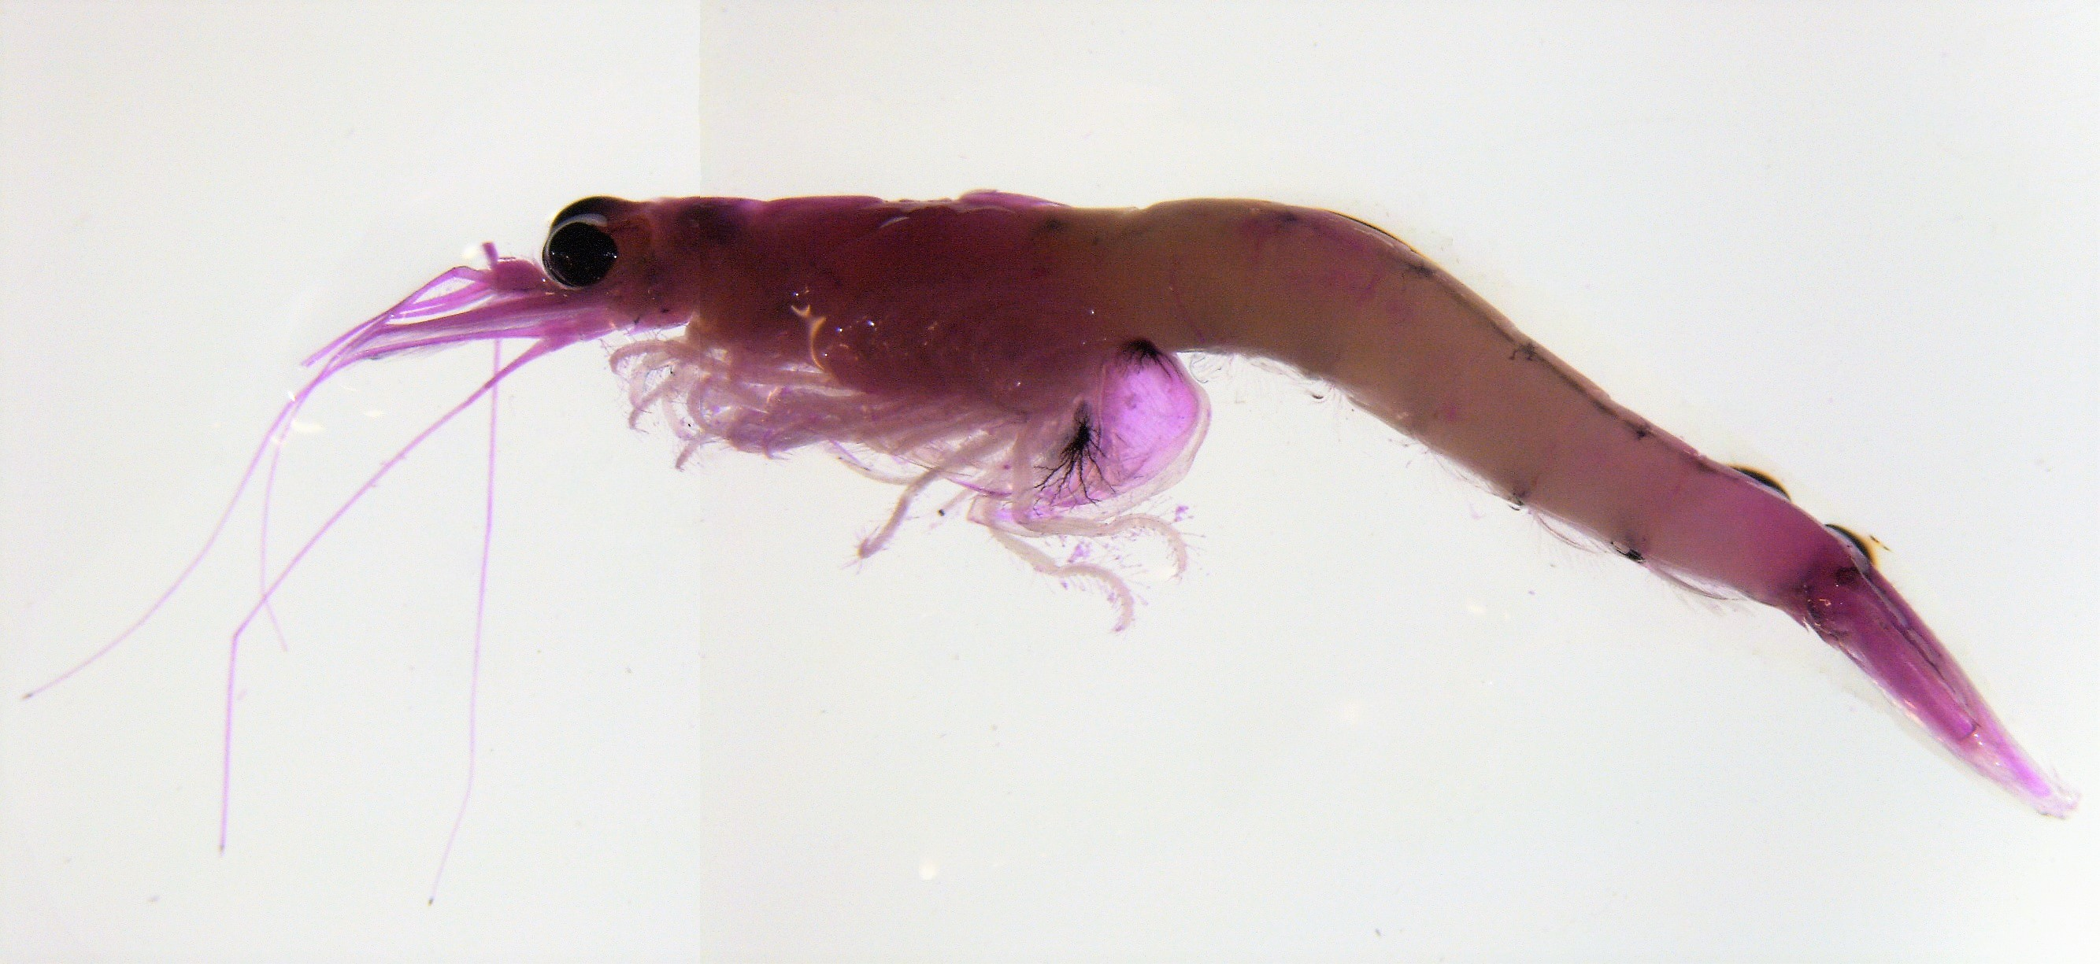
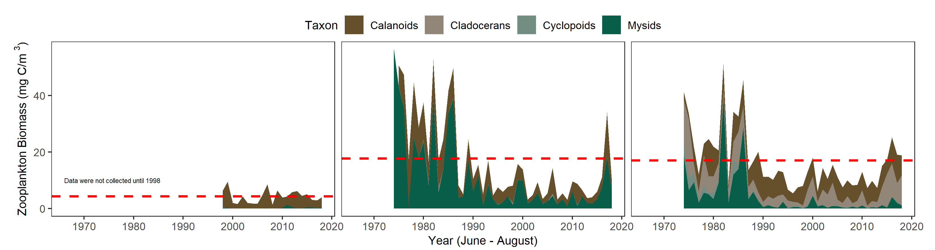
Zooplankton
Interagency Ecological Program 2018 Summer Season Report
Copepod
Background
Zooplankton is sampled monthly by the CDFW/DWR Environmental Monitoring Program, but sampling in San Pablo Bay did not begin until 1998.
Zooplankton are an important food source for pelagic fish.
Calanoid copepods and mysids are particularly good fish food. Cyclopoid copepods are not as good for fish food.
Biomass tends to be highest in summer.
For more information see: Hennessy, A. 2018. Zooplankton Monitoring 2017. IEP Newsletter 32(1):21-32.
Mysid
San Pablo Bay
Suisun Bay
The Delta
In 2018, San Pablo Bay had about average biomass, mostly calanoid copepods
In 2018, Suisun Bay also had slightly lower than average total biomass, mostly mysids.
In 2018, the Delta had about average total biomass, mostly cladocerans
Notes:
Do we change the x axis so we can see it?
Also, Nick made these plots narrower and taller than the others.

Slide 6
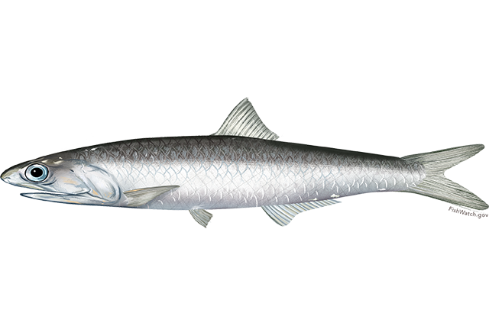
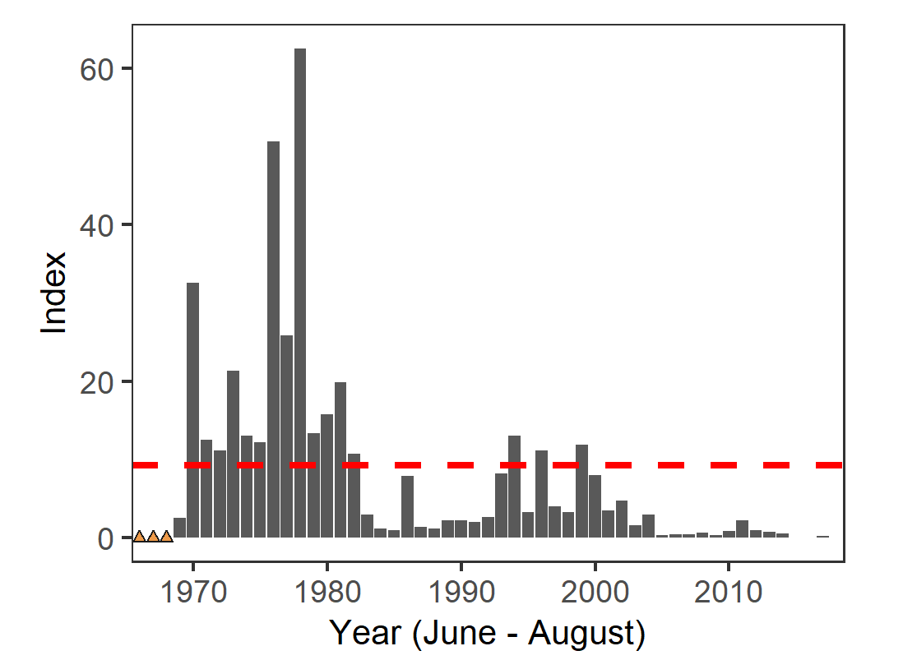
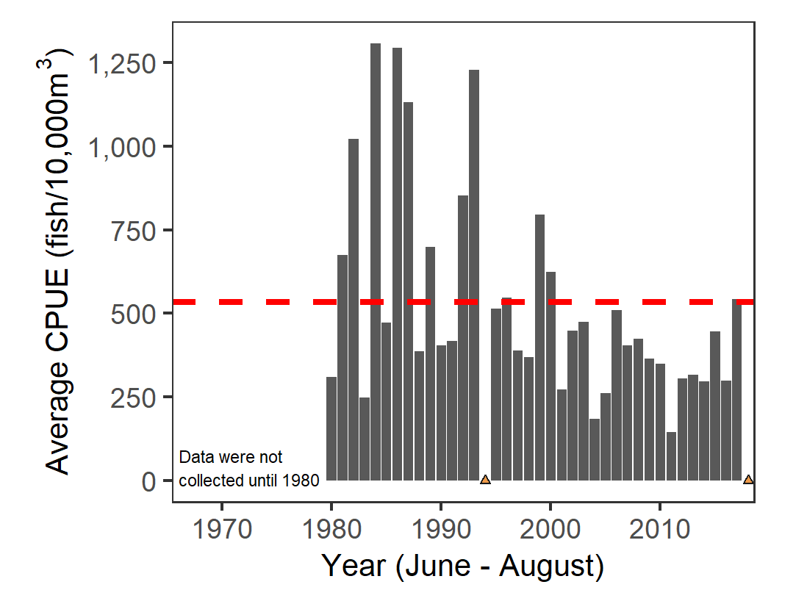
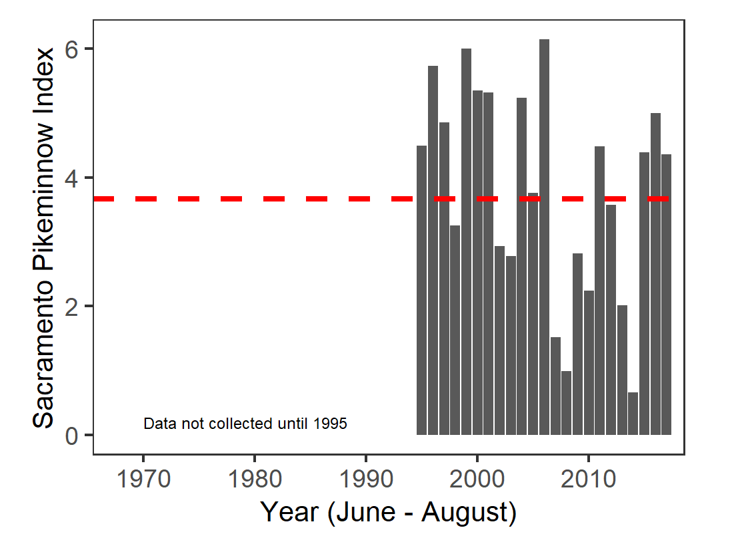
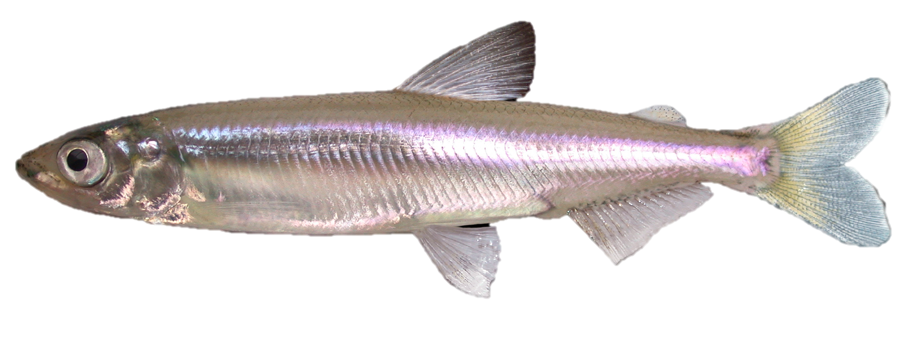
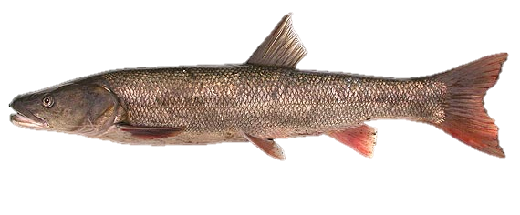
Fish
Interagency Ecological Program 2018 Summer Season Report
Background
Delta Smelt, listed as threatened by the Endangered Spices Act, have been tracked by CDFW’s Townet Survey since 1959 in Suisun Bay, San Pablo Bay, and the Delta.
Northern Anchovy are an important forage fish in the brackish-saline regions of the estuary. They are sampled best by CDFW’s San Francisco Bay Study.
Sacramento Pikeminnow is a native cyprinid that is one of the few piscivorous native fish in the Delta. They are sampled by DJFMP’s beach seine surveys throughout the estuary.
For more information, see: Hieb, K., J. Bautista, and J. Giannetta. 2018. Bay Study Fishes Status and Trends Report for the San Francisco Estuary, 2012–2016. IEP Newsletter 31(2):3-43.
Delta Smelt - Townet
Anchovy – Bay Study
DJFMP – Sac Pikeminnow
No sample
2018 was lower than the long-term average.
The Bay Study did not sample in 2018, but 2017 catch was about average.
In 2018, Pikeminnow were slightly more abundant than average

Slide 7
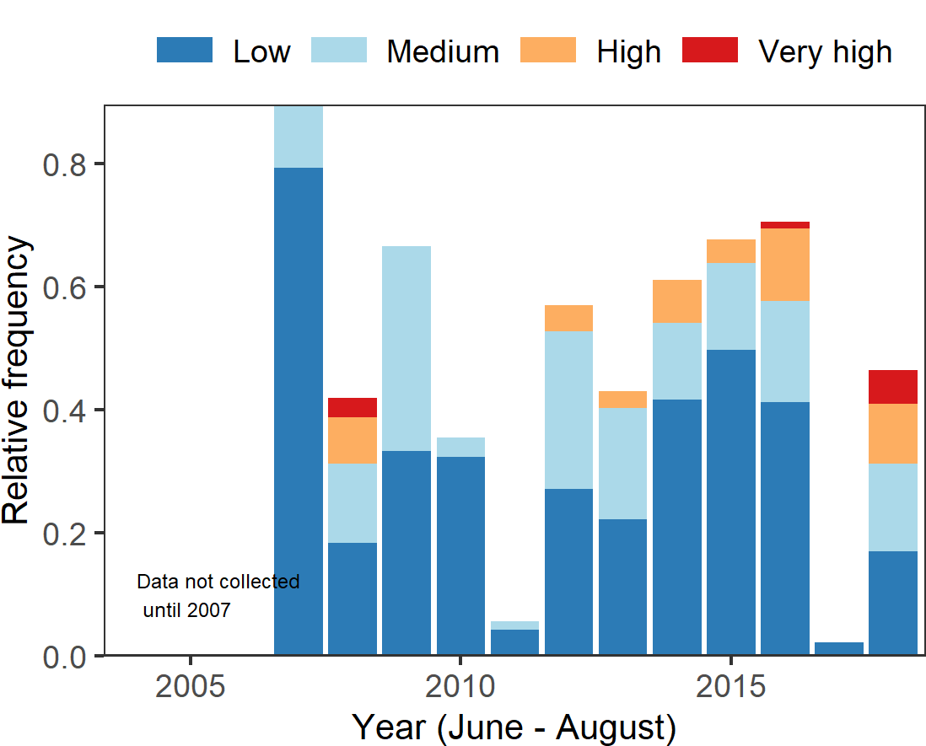
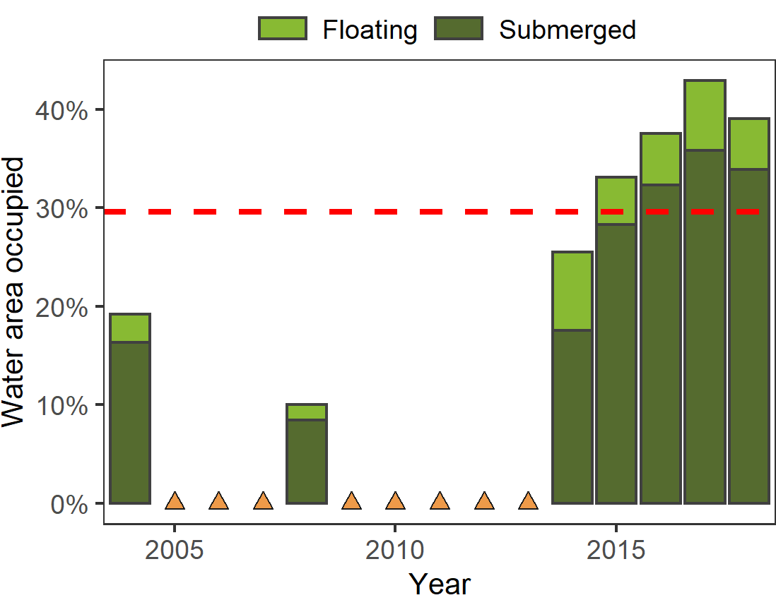
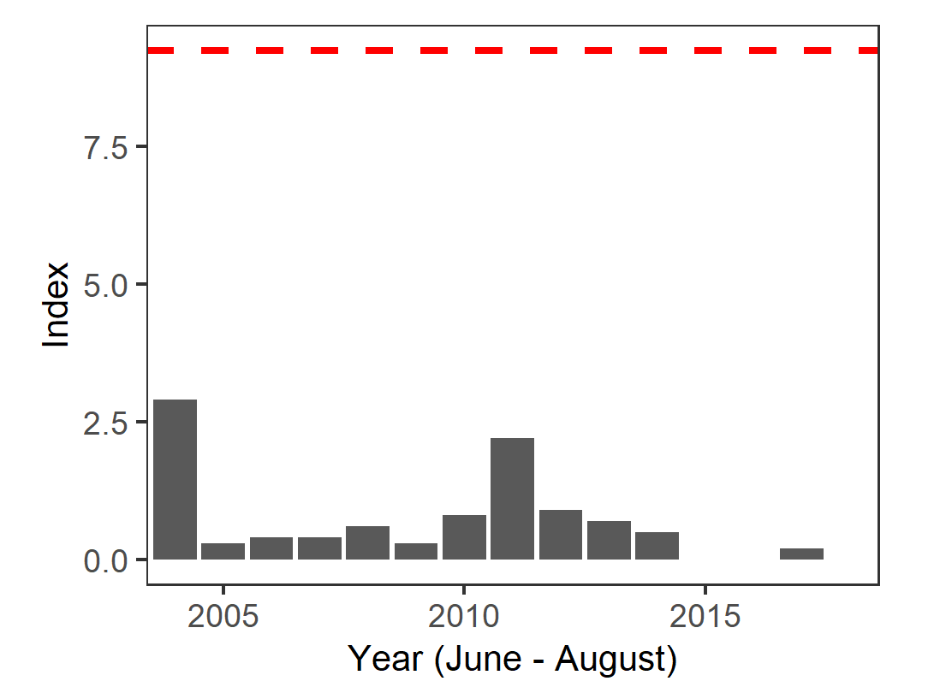
Recent Trends: 2004-2018
Interagency Ecological Program 2018 Summer Season Report
Background
Delta Smelt have been in severe decline over the past two decades, with a Summer Townet index of zero in 2015, 2016 and 2018.
Microcystis is a toxic cyanobacteria first found in the Delta in 1998. Microcystis presence has been documented by EMP and the Summer Townet Survey during their water quality sampling.
Aquatic vegetation in the Delta has increased significantly in recent years. This vegetation is composed mostly of non-native invasive plant species and is categorized as either floating or submerged types. Coverage is estimated by UC-Davis using remote sensing of the North and Central Delta.
For more information, Ta et al. 2017. Invasive aquatic vegetation management in the Sacramento–San Joaquin River Delta: status and recommendations. San Francisco Estuary and Watershed Science 15(4)
Delta Smelt - Townet
Microcystis
Aquatic Vegetation
No sample
The 2018 Delta Smelt index was 0.
2018 had more observations of very high Microcystis than previous years.
Aquatic vegetation was slightly lower than 2017, but higher than average.

